Slide 1
DiversityRate - A DIVERSITY AND INCLUSION TRUST, REPUTATION AND RATING SYSTEM
By Mary Namayanja

Slide 2
“Human and not financial capital must be the starting point and ongoing foundation of a successful strategy”
- Barlett & ghoshal

Slide 3
Problem Statement
In 2020, worldwide racial injustice riots mainly driven by Black Lives Matter (BLM) movement in the US after the George Floyd murder led to recognition that racial injustice problem had not been solved.
In Corporate America, this resulted in a shifting mindset and movement on D&I at the workplace and many companies have revamped the old D&I framework, emphasized D&I accountability at leadership level and hired new D&I executives.
These internal efforts are a positive step in the right direction however, an industry standard or index does not exist to continuously benchmark companies D&I performance
A D&I reputation and rating system that leverages AI and data driven capabilities to design a reputation and rating system or index is a game changer to provide a benchmark
Glassdoor provides some company reviews, for example, but these are too general and not specific to D&I and do not allow users to make informed decisions about the D&I performance of the organization.

Slide 4
Why A Solution
The Internet has enabled new marketplaces for goods and services, including accommodation and rentals using Airbnb, food delivery using Grubhub, ridesharing using Uber and Lyft, and shopping using eBay that has thousands of sellers from more than thirty different countries.
These platforms enable new kinds of transactions and have benefited from AI and data driven and AI reputation and rating systems to build trust and guard against low quality services and products.
Similarly, a D&I trust, reputation and rating system will drive more accountability, trust and create lasting D&I experience for all customers.
Ethics is at the core of any successful organization and it is time to implement a consistent and robust industry index for D&I leveraging AI and data.
Human capital is the foundation of company success and a D&I industry rating and benchmark tool is a lasting solution and investment in human capital and it will create credibility for the company that participates thus solving reputation risk problems
The tool has opportunity to generate revenues by charging a small premium fee for corporations and to make it free for external users e.g., customers and job seekers and a percentage of the profits will be pledged/donated to improve D&I in impacted communities

Slide 5
Target Industry & Customers
The rating system will have a feedback loop and customers can provide reviews
There is no primary industry/sector for this idea and all industries including financial services, health care, retail, consulting could benefit from this solution
The target market/customers for this idea is all market/customers seeking to solve D&I problem including internal customers to the company e.g., leaders, employees, HR teams and external customers e.g., regulators, vendors, product users, job seekers. This solution will give the company a positive perspective internally e.g., employees and externally e.g., customers, job seekers, vendors.
The platform will create an interactive model and loop using a D&I ID or index tracking performance for the corporation. This will allow for feedback, improvement and sustainability.
There is no comparable solution and although Glassdoor provides some company reviews the proposed solution will not be subject to competition since it will focus on becoming the most used industry benchmark for determining the state of D&I, similar to how S&P index has distinguished itself as the most used benchmark to determine state of overall economy.
Risks include exposure of information e.g., some companies may not want to share the D&I metrics and similarly users e.g., job seekers and vendors may face similar information exposure risks. To mitigate this, the strategy is to limit information shared and to leverage IDs for anonymous feedback.

Slide 6
Implementation
Company A sets up profile on D&I index platform
Company A is assigned ID
Company A provides D&I metrics
Customers e.g., job seeker, vendor accesses the platform to add review or to read a review
Platform allows users to rate reviews
Platform allows users to add independent and validated D&I metrics
Handshake and feedback loop
Company responds to reviews and provides actionable improvement next steps
INTERACTIVE

Slide 7
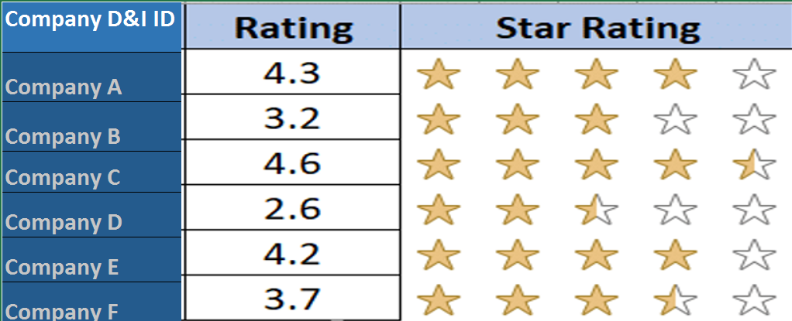
Implementation…

Slide 8
References/Links
1:BLM protests moves Corporate D&I Initiatives Center https://www.forbes.com/sites/geristengel/2020/06/17/black-lives-matter-protests-moves-corporate-di-initiatives-into-the-spotlight/?sh=13ec22b57a0d
2: Benefits of HR analytics https://blog.talview.com/8-key-benefits-of-hr-analytics#:~:text=Better%20Insights,and%20analyzing%20performance%2Drelated%20data.&text=This%20data%20not%20only%20provides,morale%2C%20retention%2C%20and%20engagement.
3: Using Data in D&I https://hrexecutive.com/using-data-accountability-to-make-the-di-difference/
4. Framework for Designing Trust and Reputation systems: https://www.mdpi.com/0718-1876/5/2/14
5. Trust Building Online: Rating and Reputation Systems https://depts.washington.edu/ccce/digitalMedia/reps.html
6: Leadership lessons - https://www.diversityincbestpractices.com/what-leaders-can-learn-from-wells-fargo-ceos-recent-comments-about-a-lack-of-black-talent/
7: Companies ramping up D&I efforts https://www.glassdoor.com/employers/blog/inspiration-for-ramping-up-diversity-inclusion-efforts/
8: Banking Industry – Banks D& I pledge examples
JPMorgan D&I pledge: https://www.reuters.com/article/jpmorgan-diversity/jpmorgan-pledges-30-billion-to-address-racial-wealth-gap-idUSKBN26T0H0
Citibank D&I pledge: https://www.forbes.com/sites/ruthumoh/2020/09/23/citi-pledges-1-billion-to-narrow-the-racial-wealth-gap-confront-wealth-inequality/?sh=266e3f66fc93

